Slide 1
Space Invaders
By Team Klondike

Slide 2
Team Klondike
Blake North - Game Director
Ava Datsko - Producer
Teada Nguon - Sound Lead
Adithi Arun - Art Lead
Blake North - Tech Lead
Runa Chernik – Game Design Lead
Addison Knapman – Artist
James Ouyang - Programmer

Slide 3
Game Background
Space invaders is a two- dimensional, single player fixed shooting game in which the player is instructed to attack the descending aliens using a laser cannon.

Slide 4
Original Gameplay / Our Changes
Laser controlled with left and right arrow keys
Shoot laser with space bar
Enemies moving from side to side
Enemies shooting at player
Decaying shields
No changes to gameplay in our replica

Slide 5
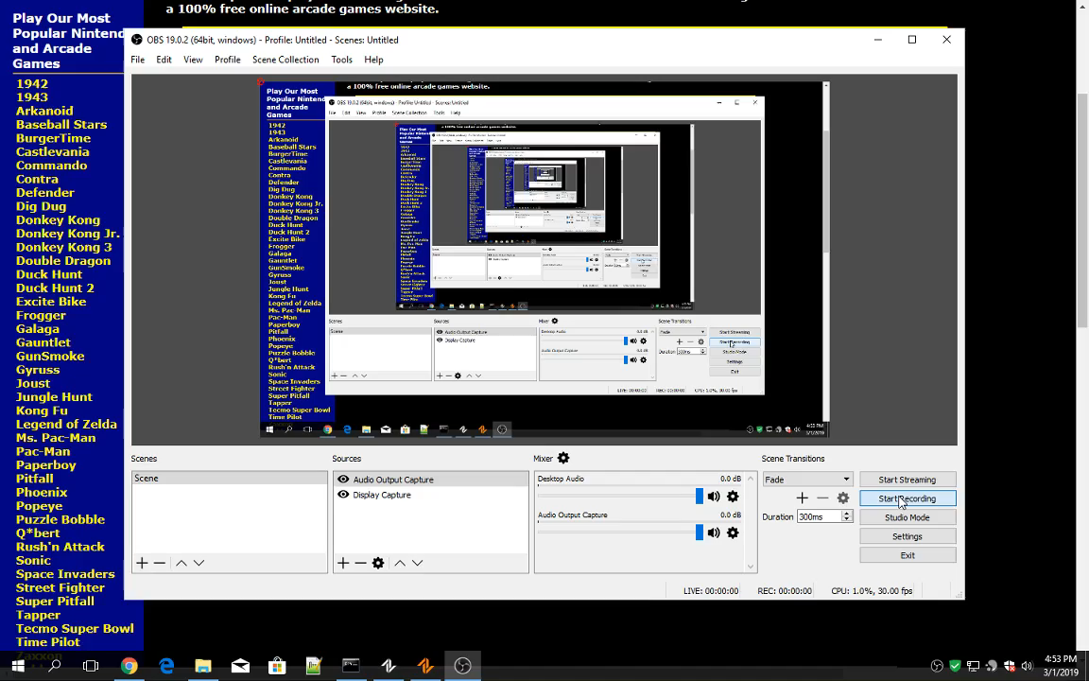
Demo – Original and Replica

Slide 6

Art Assets
Our assets
Plus Assets
Original Assets

Slide 7








Scrapped Ideas

Slide 8
Sounds Assets – Original and Replica
 | Background | Player Shooting | Enemy Fire | Enemy Death
Original
Assets
1. Generate Noise (Noise/Chirp)
2. Amplify and Pitch
3. Low /High Pass, Limiter, Studio Fade

Slide 9
What We Learned – Risks and Mitigations
Exporting pixel art in larger dimensions
Game Director unavailable – reassigned role
Enemy Movement proved challenging for the Programming Team – asked for additional assistance

Slide 10
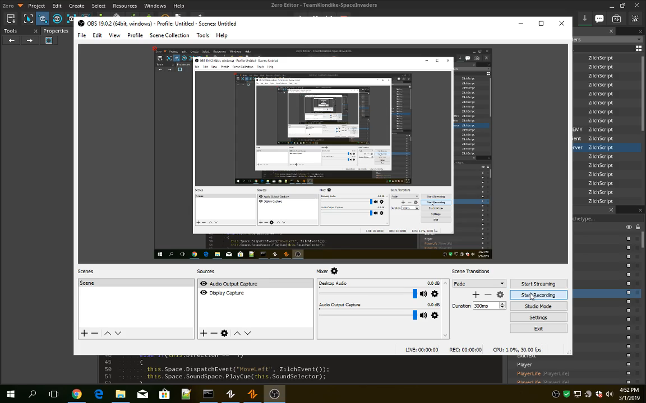
Final Product

Slide 11
Thank you for your time.

